Slide 1
Advanced higher Graphic communication
3D Printing

Slide 2
Learning intentions & success criteria
Learning Intentions
Gain an Understanding of 3D Printing
Success Criteria
Explain the file type requirements for 3D printing.
Describe the set up requirements for 3D Printing.

Slide 3
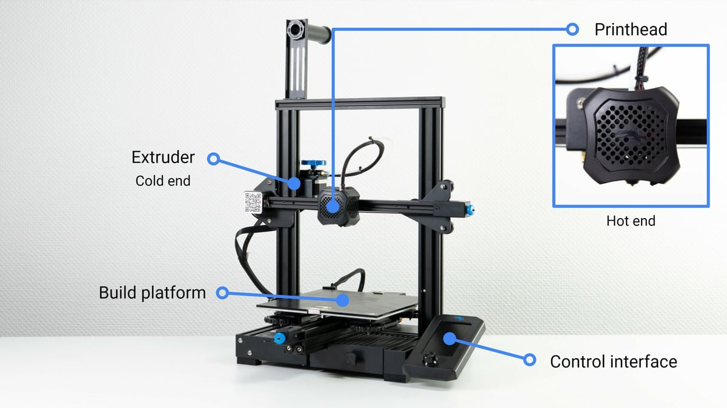
3D printing
What is 3D Printing?
There are many different 3D printing technologies, but fused deposition modelling (FDM), is the most common.
FDM works by using thermoplastic filament, which is basically a cord of plastic that can be melted, selectively deposited, and cooled. This is repeated, layer by layer, until an entire model is formed.

Slide 4
3d printing
Parts of a 3D Printing Machine.
Build platform: The build platform is essentially the surface on which the parts are made. Build platforms usually include heated beds to make it easier for parts to stick to them.
Extruder: The extruder is the component responsible for pulling and pushing the filament through the print head. The extruder consists of two sub-components:
The cold end is the mechanical portion that consists of a motor, drive gears, and other small components that push and pull the filament.
The hot end contains a heater and a nozzle, where the former heats up the filament so that it can be extruded out of the latter.
Control interface: Some modern 3D printers have a touchscreen that’s used for controlling the 3D printer. On older printers, a simple LCD display with a physical scroll and click wheel may be present instead of a touch interface.

Slide 5
3d printing
Pre Printing Requirements.
Naturally, if you want to 3D print a part, you have to have a 3D model of that part. 3D models are created using 3D modelling software, such as Autodesk Inventor. These files are normally saved as .stl file types, as it is the most common file type for 3D printing. This format describes only the surface geometry of a three-dimensional object without representing colour, texture, or other common model attributes
Once a model is finished in 3D design software, it still needs to be prepared using a special kind of software that translates the model into the script of machine instructions.
After importing your 3D model into the 3D printer software, you can adjust the settings to meet your requirements. You can set many important parameters, such as printing speed, orientation, wall thickness, infill percentage, layer height, and many others.

Slide 6
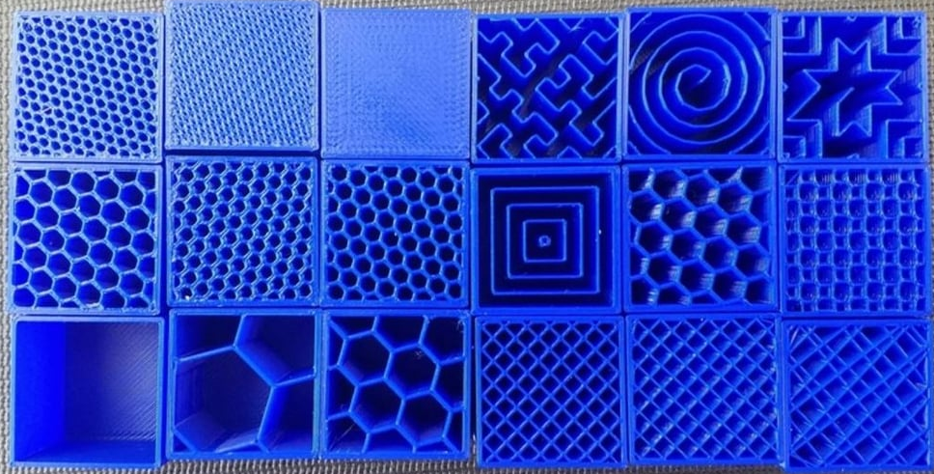
3D printing
Infill
Infill is the structure of the material inside a 3D printed part. Just as the underside of a bridge has interconnecting steelwork, 3D printed parts have an infill that manipulates the part’s physical properties, including strength, structure, and weight.
The two most important aspects of infill are infill density and infill pattern.
The infill density is the amount of material used for the infill. The denser the infill, the fuller, heavier and (in theory) the stronger the part.
Infill density is measured as a percentage: 0% is hollow, and 100% is solid.
The infill pattern is the structure of the infill. These range from basic lines to intricate honeycombs and lattices. Different infill patterns have different characteristics, like higher strength, rigidity, flexibility, buoyancy and weight load.

Slide 7
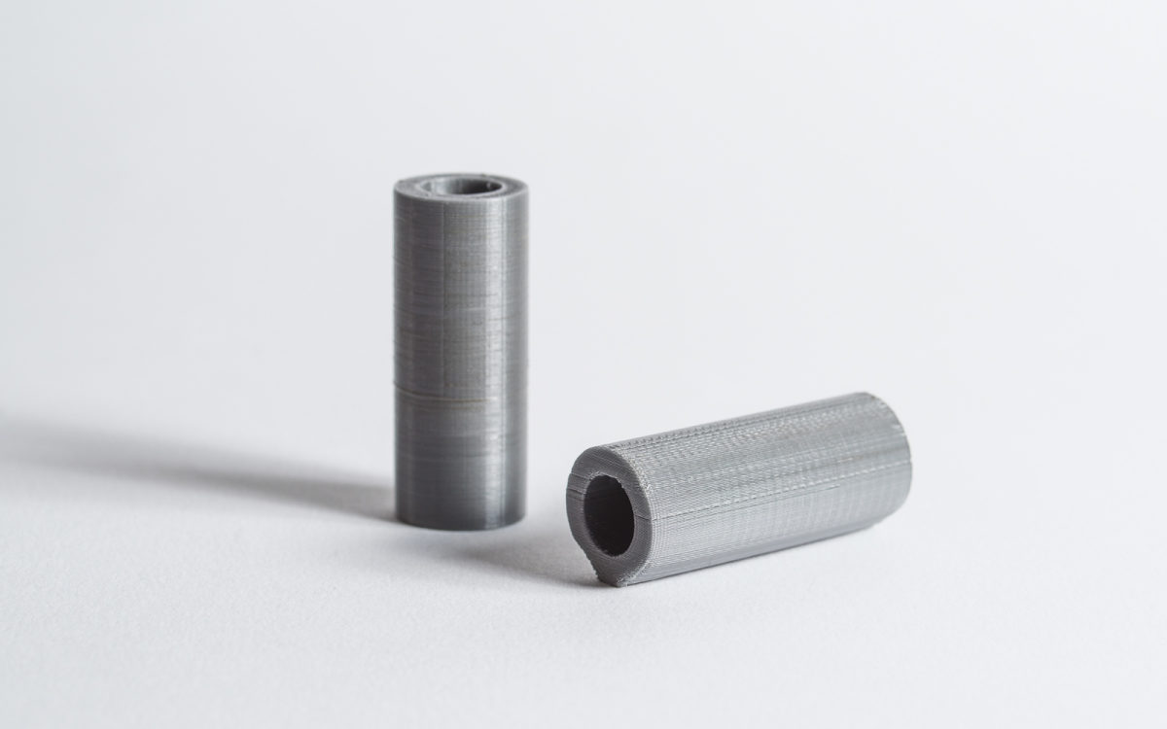
3D printing
Orientation
One of the most important decisions when 3D Printing is the orientation you print the model in. Considerations must be made to minimize required support material, ensure a reliable print with the best surface quality and maximize strength.
To understand how part orientation affects the accuracy of 3D-printed parts, consider the humble cylinder. Let’s say you’re using FDM to print a cylinder with a hole (10 mm outer diameter, 6 mm inner diameter, 30 mm length) with its centre axis vertical. The 3D printer will construct this part as a series of concentric circles layered on top of one another, producing a final cylinder with a relatively smooth outer surface.
Suppose the same cylinder is reoriented with its centre axis horizontally. The part will be built as a series of rectangles (with slightly different widths) layered on top of each other. Also, the surface of the cylinder that touches the build platform will be flat.

Slide 8
3D Printing
Layer Height
As the name suggests, layer height refers to the exact height of each layer of plastic extruded, cured, or sintered by a 3D printer. This setting is adjusted with a slicer program and has a significant effect on the final print. Used properly, this setting can increase your print’s speed, resolution, and smoothness.
Generally, increasing layer height will decrease the resolution and quality of your print

Slide 9
?
?

Slide 10
?
?

Slide 11
?
?

Slide 12
?
?

Slide 13
?
?

Slide 14
?
?

Slide 15
?
?

Slide 16
?
?

Slide 17
?
?

Slide 18
?
?

